Slide 1
Server-side Web Development
HSQLDB

Slide 2
HSQLDB Overview
An opensource SQL database implemented in Java.
Runs in 3 modes
In memory
File based
Server-based.
We are interested in Server-based, which can handle a number of connections at the same time.

Slide 3
Why HSQLDB?
Implemented in Java.
We can store in our Eclipse Project:
The Database software (jar file)
The database itself (data)
Everything is part of the Eclipse project.

Slide 4
Configuring the Database
Create a folder called db.
Put the file manageDB.xml into that folder.
This is an Ant script that we will use to start the database.
The database will be called oneDB and exist as 4 files in the db folder.
Put the jar file hsqldb.jar into the lib folder.

Slide 5
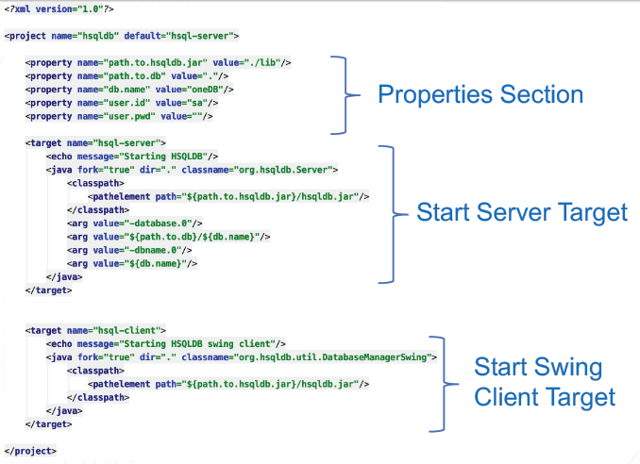
ManageDB.xml

Slide 6
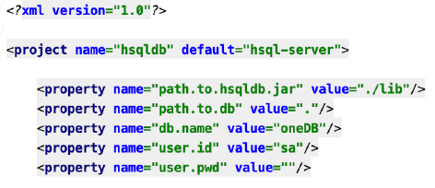
ManageDB.xml - properties
TYPO!!!!
Value=“../lib”
Already done
in file on
moodle

Slide 7
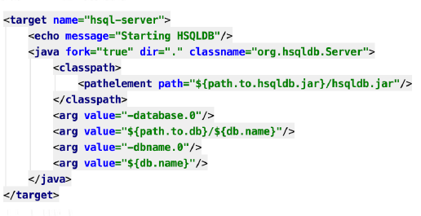
ManageDB.xml – run server target

Slide 8
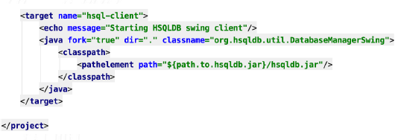
ManageDB.xml – start Swing client

Slide 9
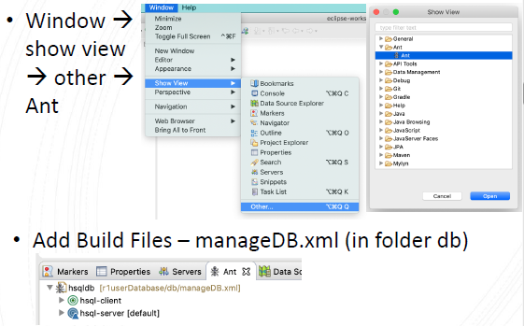
Ant View in Eclipse

Slide 10
Database Server and Client
In order to use the database, it is necessary to start the database server.
This creates a database called oneDB, or uses oneDB if it already exists.
The database exists as a number of files in the db folder such as
oneDB.properties
oneDB.script
oneDB.log
oneDB.lck

Slide 11
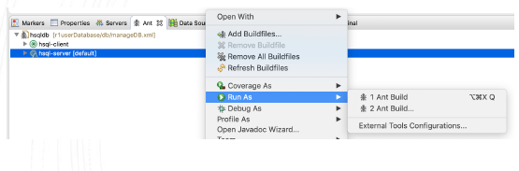
HSQLDB Database Server
To start
hsql-server -> Right Click -> Run as -> Ant Build
The database can now be accessed from our Web application as well as from an SQL client.

Slide 12
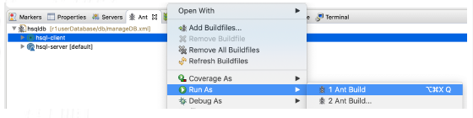
HSQLDB Database Client
To start
hsql-client -> Right Click -> Run as -> Ant Build
Once the Swing GUI Client opens we need to enter correct settings

Slide 13
HSQLDB Database Client
Type (3rd option)
HSQLDB Database Engine Server
URL
jdbc:hsqldb:hsql://localhost/oneDB
This is a general purpose SQL client that allows us to see the database structure and submit SQL statements.

Slide 14
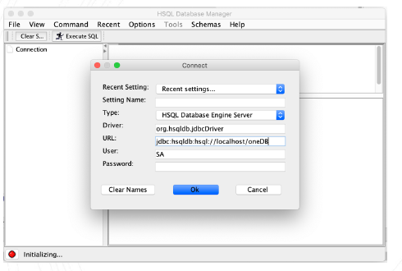
HSQLDB Database Client

Slide 15
HSQLDB – Stopping the Database Server
To stop
Run SHUTDOWN from client.
Note
If you kill it in console window.
Need to kill the Java process in Task manager before starting the database server again.

Slide 16
HSQLDB – Database Server Port
If you attempt to run the HSQLDB server twice you will get the error
java.net.BindException: Address already in use: JVM_Bind
The database server listens on a TCP/IP port for SQL requests (9001)
Only one process can listen on this port.

Slide 17
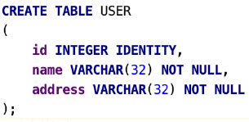
HSQLDB – Example Create Table

Slide 18
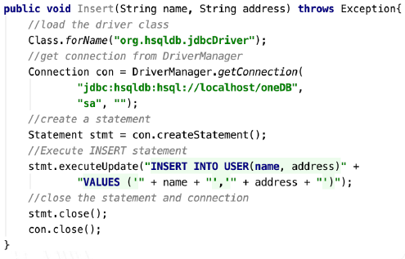
HSQLDB – INSERT Records

Slide 19
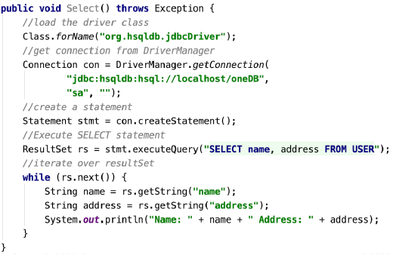
HSQLDB – SELECT Records

Slide 20
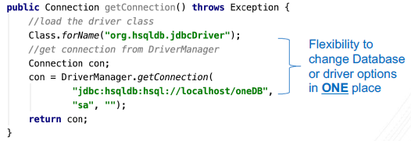
DAO – Get Connection
Move connection related logic to separate method.
Easier to update in one place if Database and/or driver details change.

Slide 21
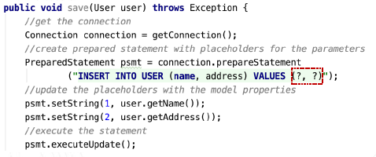
DAO – JDBC PreparedStatement
This should always be used in Web applications.
Uses ? symbol as placeholders for variables
It stops SQL injection attacks, a major form of attack on Web applications.

